Slide 1



Course: Image Processing 31651 Assignment #21 Pixel to Pixel Operations (Part 1)
Photo of the student | Shorten Name | ID (4 last digits)
 | shienfeld | 1950 | Student #1
 | pony | 2210 | Student #2
 | akimov | 7939 | Student #3
Photo of the student | Shorten Name | ID (4 last digits)
 | shienfeld | 1950 | Student #1
 | pony | 2210 | Student #2
 | akimov | 7939 | Student #3

Slide 2

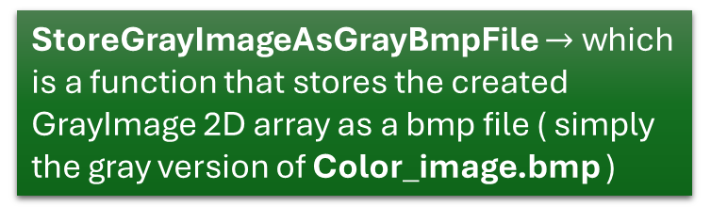
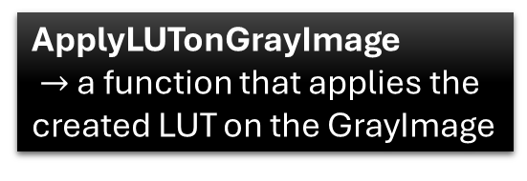
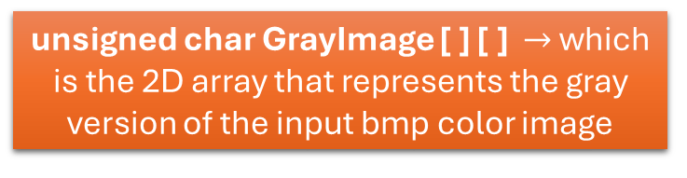
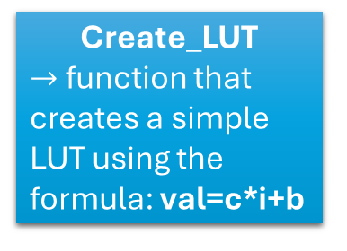

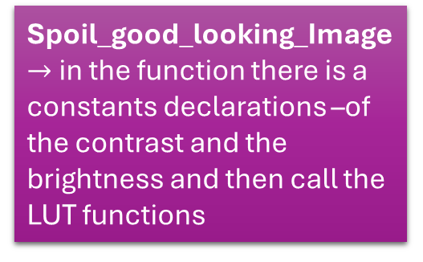
Color_image.bmp (320x240 dimensions and from CGA true-color (24 bpp) bmp file type)
LoadGrayImageFromTrueColorBmpFile
StoreGrayImageAsGrayBmpFile $→$ which is a function that stores the created GrayImage 2D array as a bmp file ( simply the gray version of Color_image.bmp )
unsigned char GrayImage [ ] [ ] $→$ which is the 2D array that represents the gray version of the input bmp color image
Min_Max_Algorithm $→$ in the function there is a constants declarations –of the contrast and the brightness and then call the LUT functions (different constants from Spoil_good_looking_Image)
Create_LUT
$→$ function that creates a simple LUT using the formula: val=c*i+b
ApplyLUTonGrayImage
$→$ a function that applies the created LUT on the GrayImage
Spoil_good_looking_Image $→$ in the function there is a constants declarations –of the contrast and the brightness and then call the LUT functions
StoreGrayImageAsGrayBmpFile $→$Store the new GrayImage as a bmp file (after transformation using LUT)

Slide 3
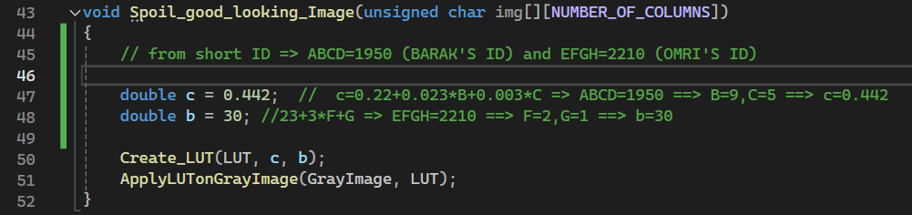
Pay attention to ‘c’ and ‘b’ values – corresponding the IDs of the group
After ‘c’ and ‘b’ declarations – create using them a simple LUT and then apply the LUP on the gray image (img [ ] [ ] )

Slide 4
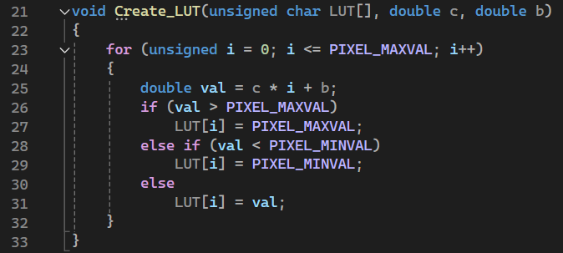
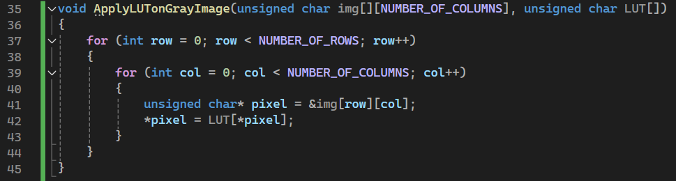
Create_LUT is a very simple function for creating a LUT using the contrast (c) and brightness (b) constants.
After defining the LUT – we need to apply the LUT of the original gray image (img [ ] [ ] )

Slide 5
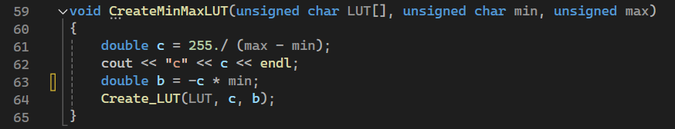
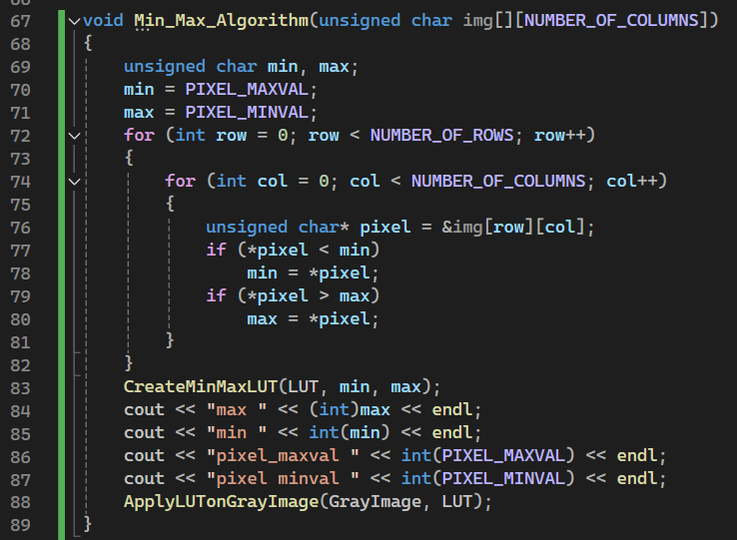
Another LUT creation function – now for the min_max_algorithm.
The max value is 255 and the min value is 0 (in grayscale). Now, the ‘c’ and the ‘b’ are defined differently then they were defined for the Spoil_good_looking_Image algorithm
The first part of the function finds the minimum and maximum pixel values in the image.
min is initially set to the maximum possible pixel value (255), and max is set to the minimum possible pixel value (0).
The function then iterates through each pixel in the image. For each pixel : If the pixel value is less than min, min is updated to this pixel value. If the pixel value is greater than max, max is updated to this pixel value.
By the end of these loops, min holds the smallest pixel value in the image, and max holds the largest pixel value.
After finding the minimum and maximum pixel values, the function creates a LUT to normalize the pixel values.
Finally, the LUT is applied to the image to adjust the pixel values.

Slide 6
21.# What did we learned
We learned to implement algorithms and functions that deal with image properties such as: contrast & brightness.
2) We learned to find the optimal outcome of an image using mathematical way so the image will look the best.
3)We used, practiced and implemented methods involving LUT which is an essential concept in Image Processing

